Slide 1
Electrical Team
Julie Laferty, Jay Merveilleux, Jeremy Jiang, Russell Ridley, Jeremy Cruz
– Weekly Update
4/5/24 – 4/12/24

Slide 2
Accomplishments
Overall Goal
Figuring out main sections of the electrical components of the bike
Dividing up the work between all members
Individual Goals
Research about each topic to share with the group
Decide on what portion to do
Start to slowly figure out cost
Motor – Jay
Battery & BMS – Jeremy & Jeremy
Controller – Julie
Throttle – Undecided
Sensors – Undecided
Notes:
Crazy week, just got two new members, everything is still a bit undecided as of now

Slide 3
Motor
DC Motors
Overview
Motors will allow the bike to move
Planning to make from scratch
Make a safe, cost-effective solution
Why DC?
While AC motors may have better efficiency compared to DC motors, it is far more complicated to work with AC than DC (Phasor and Laplace Domain)
Easier to implement and understand
Overview
Motors will allow the bike to move
Planning to make from scratch
Make a safe, cost-effective solution
Why DC?
While AC motors may have better efficiency compared to DC motors, it is far more complicated to work with AC than DC (Phasor and Laplace Domain)
Easier to implement and understand

Slide 4
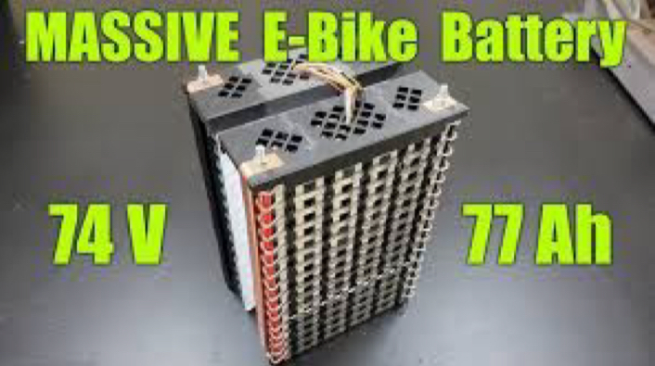

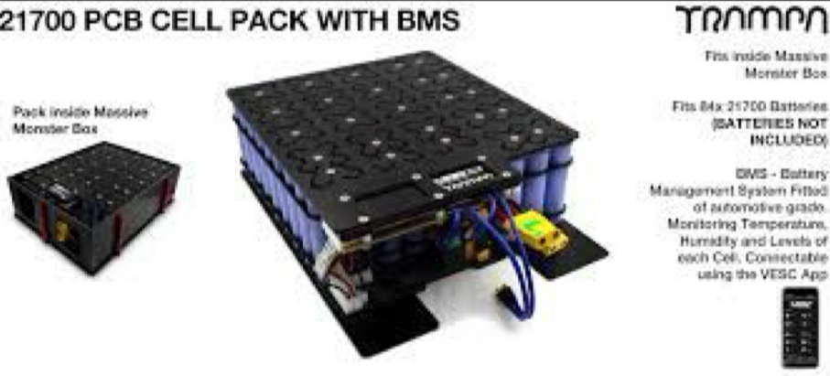
How Battery & BMS Work
18s18p battery
Configuration & Motors chosen by
Speed, range, acceleration etc.
BMS (Battery Management System)
What the battery connects to before all else (fuses, and rest of electronics)
Most commonly used battery type: lithium ions
Energy Density (amount of energy they can store for their size)

Slide 5
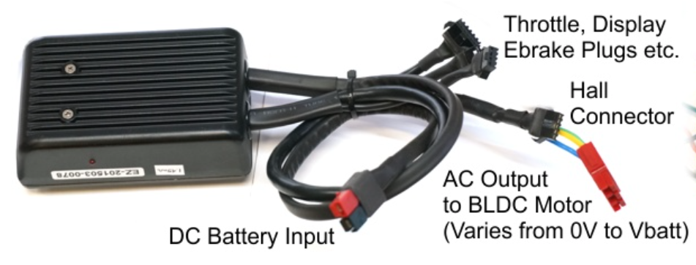
Controller
Overview
Converts DC voltage into alternating current
Continuously adjusts voltage going into the motor
Low amp controller on large motor
Will only draw the max amps (like 14 amp)
High amp controller on small motor
Risk overheating and damaging
Will auto reduce the voltage going to the motor
Work fine but won’t get as much power from motor

Slide 6

Add-ons
Throttle
Regulate amount of power from motor
Sensors
PAS & Torque
Ebrake – safety cutoff
Hall sensors

Slide 7
Summary
Motor
To be DC as of now
Try to work with mechanical on it
Battery
To be lithium ion
Focus on BMS system
Controller
Size depends on motor size
Leaning towards bigger amp
Try to work with mechanical on it
Add-ons
Throttle, Ebrake, PAS, Torque
Focusing on throttle and ebrake

Slide 8
Next Week Goals
Cost
Report an estimated cost report to financial
Parts
Quantity count
To divide up work easier and keep organized
Design
Work with mechanical & safety

